Slide 1
Decomposition and its Properties

Slide 2
Definition
Decomposition is the process of breaking down in parts or elements.
It replaces a relation with a collection of smaller relations.
It breaks the table into multiple tables in a database.
It should always be lossless, because it confirms that the information in the original relation can be accurately reconstructed based on the decomposed relations.
If there is no proper decomposition of the relation, then it may lead to problems like loss of information.

Slide 3
The process of normalization depends on being able to factor or decompose a table into two or more smaller tables, in such a way that we can recapture the precise content of the original table by joining the decomposed parts.
When a relation in the relational model is not in appropriate normal form then the decomposition of a relation is required.
If the relation has no proper decomposition, then it may lead to problems like loss of information.
Decomposition is used to eliminate some of the problems of bad design like anomalies, inconsistencies, and redundancy.

Slide 4
Decomposition
Student-Examination
SID | Name | Subject | S-Code | Marks
101 | Animesh | DBMS | S-1 | 72
101 | Animesh | C | S-2 | 90
101 | Animesh | OS | S-3 | 94
102 | Ujjwal | DBMS | S-1 | 82
102 | Ujjwal | C++ | S-4 | 76
102 | Ujjwal | Java | S-5 | 42

Slide 5
Decomposition
Student
Examination
SID | Name
101 | Animesh
102 | Ujjwal
Subject | S-Code | Marks
DBMS | S-1 | 72
C | S-2 | 90
OS | S-3 | 94
DBMS | S-1 | 82
C++ | S-4 | 76
Java | S-5 | 42

Slide 6
Types of Decomposition
Decomposition is of two major types in DBMS:
Lossless
Lossy

Slide 7
1. Lossless Decomposition
A decomposition is said to be lossless when it is feasible to reconstruct the original relation R using joins from the decomposed tables. It is the most preferred choice. This way, the information will not be lost from the relation when we decompose it. A lossless join would eventually result in the original relation that is very similar.
For example,
Let us take ‘A’ as the Relational Schema, having an instance of ‘a’. Consider that it is decomposed into: A1, A2, A3, . . . . An; with instance: a1, a2, a3, . . .. an, If a1 ⋈ a2 ⋈ a3 . . . . ⋈ an, then it is known as ‘Lossless Join Decomposition’.

Slide 8
2. Lossy Decomposition
Whenever we decompose a relation into multiple relational schemas, then the loss of data/information is unavoidable whenever we try to retrieve the original relation.

Slide 9
Lossy and Lossless decomposition
ABC
A | B | C
1 | 100 | C1
2 | 200 | C2
3 | 300 | C3
4 | 200 | C4

Slide 10
Lossy and Lossless decomposition
AB
BC
A | B
1 | 100
2 | 200
3 | 300
4 | 200
B | C
100 | C1
200 | C2
300 | C3
200 | C4

Slide 11
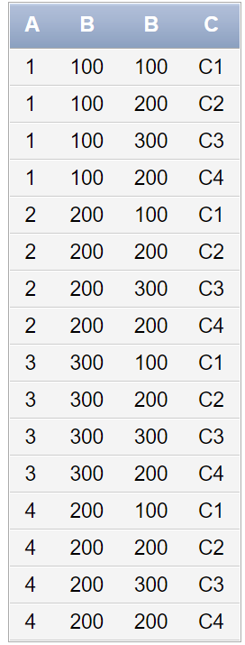
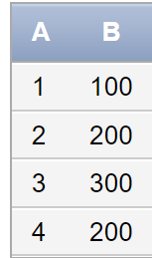
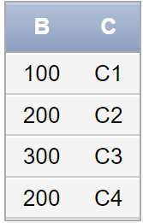
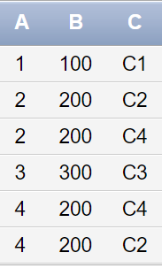
Lossy and Lossless decomposition
select * from AB cross join BC
select * from AB natural join BC

Slide 12
Lossy and Lossless decomposition
A | B | C
1 | 100 | C1
2 | 200 | C2
3 | 300 | C3
4 | 200 | C4
Common attribute should be candidate key or super key
A | B
1 | 100
2 | 200
3 | 300
4 | 200
A | C
1 | C1
2 | C2
3 | C3
4 | C4

Slide 13
Lossy and Lossless decomposition
Lossless join decomposition is a decomposition of a relation R into relations R1, R2 such that if we perform natural join of two smaller relations it will return the original relation.
This is effective in removing redundancy from databases while preserving the original data.
In Lossless Decomposition we select the common element and the criteria for selecting common element is that the common element must be a candidate key or super key in either of relation R1,R2 or both.
Spurious Tuples are those rows in a table, which occur as a result of joining two tables in wrong manner. They are extra tuples (rows) which might not be required.

Slide 14
Properties of Decomposition
Desirable properties of decomposition are given below:
Lossless-join decomposition [Compulsory property]
Attribute preservation [Compulsory property]
Dependency preservation [Optional]
Lack of redundancy

Slide 15
I. Lossless-join decomposition
Decomposition must be lossless. It means that the information should not get lost from the relation that is decomposed.
It gives a guarantee that the join will result in the same relation as it was decomposed.

Slide 16
Lossy and Lossless decomposition
Mandatory Property: Lossless join decomposition guarantees that the extra or less tuple generation problem does not occur after decomposition. [It is a mandatory property must always hold good]
Decomposition of a relation R into R1 and R2 is a lossless-join decomposition if:
A(R1) U A(R2) = A (R)
A(R1) ∩ A(R2) ≠ Null
R1 ∩ R2 → R1
OR
R1 ∩ R2 → R2

Slide 17
Example- Emp_Dept Table
The above relation is decomposed into two relations i.e. Emp and Dept
R1: Emp will have Eid, Ename, Age, City, Salary
R2: DeptId, Dname, Eid
The above relations are decomposed in R1 and R2 and it is a lossless join decomposition, because the two relations contains one common field that is ‘Eid’ and therefore join is possible.
Now, the NATURAL JOIN can be apply on the decomposed relations.
It is an lossless join.
Eid | Ename | Age | City | Salary | DeptId | Dname
E001 | ABC | 29 | Pune | 20000 | D001 | Finance
E002 | PQR | 30 | Pune | 30000 | D002 | Production
E003 | LMN | 20 | Mumbai | 5000 | D003 | Sales
E004 | XYZ | 22 | Mumbai | 4000 | D004 | Marketting
E005 | STU | 24 | Bangalore | 25000 | D005 | Human Resource

Slide 18
Decomposition of a relation R into R1 and R2 is a lossless join decomposition if:-
A(R1) U A(R2) = A (R)
A(R1) ∩ A(R2) ≠ Null
R1 ∩ R2 → R1
OR
R1 ∩ R2 → R2

Slide 19
II. Attribute preservation
The attribute in R will appear in at least one relation schema Ri in the decomposition i.e. no attribute is lost. This is called the attribute preservation condition of decomposition.

Slide 20
III. Dependency preservation
Dependency is an important constraint on the database.
Every dependent must be satisfied by at least one decomposed table.
If{A→B} holds, then two sets are functional dependent. And, it becomes more useful for checking the dependency easily if both sets in a same relation.
This decomposition property can only be done by maintaining the FD.
In this property, it allows to check the updates without computing the natural join of the database structure.

Slide 21
Dependency preservation cont…
The dependency preservation decomposition is another property of decomposed relational database schema D in which each functional dependency X→Y specified in F either appeared directly in one of the relation schemas Ri in the decomposed D or could be inferred from the dependencies that appear in some Ri.
Decomposition D = { R1 , R2, R3,,.., ,Rm} of R is said to be dependency-preserving with respect to F if the union of the projections of F on each Ri , in D is equivalent to F. In other words, R ⊂ join of R1, R1 over X. The dependencies are preserved because each dependency in F represents a constraint on the database. If decomposition is not dependency-preserving, some dependency is lost in the decomposition.

Slide 22
Example: Dependency preservation
R (ABC)
A→B
B→C
C→A
R1(AB)
R2(BC)

Slide 23
Step 1: Checking for dependency preservation
Possible dependencies of R1 and R2
R1(AB)
R2(BC)
A→A
B→B
A→B
B→A
B→B
C→C
B→C
C→B

Slide 24
Step II. Consider only Non-trivial FDs
R1
R2
A→B (direct match)
B→A (no direct match)
Find the closure of B (use parent FDs)
B→BCA (inferred)
B→C (direct match)
C→B (no direct match)
Find the closure of C (use parent FDs)
C→CAB (inferred)

Slide 25
Step III. Final Dependencies are
i) A→B
ii) B→A
iii) B→C
iv) C→B

Slide 26
Now, match the above derived FDs with the original (parent) FDs. We found only FDs i) and iii) having the direct match.
But, FD C→A is missing.
Lets try to find whether new FDs have this C→A by using the closure of C with the help of new FDs.
C→CBA {It is capable to infer attribute A}
It means C→A dependency is preserved.
New FD B→A is new FD which is allowed.
Hence, dependency is preserved.

Slide 27
Example 2
R (ABCD)
A→B
B→C
C→D
D→B
R1(AB)
R2(BC)
R3(BD)

Slide 28
Step 1: Checking for dependency preservation
R1(AB)
R1(BC)
A→B (direct match)
B→A (no direct match)
Find the closure of B (use parent FDs)
B→BCD (inferred)
B→C (direct match)
C→B (no direct match)
Find the closure of C (use parent FDs)
C→CDB (inferred)
R3(BD)
B→D (direct match)
D→B (no direct match)
Find the closure of C (use parent FDs)
B→BCD (inferred)

Slide 29
Step II. Final FDs
i) A→B
ii) B→C
iii) C→B
iv) B→D
v) D→B

Slide 30
Step III. Match the FD with parent FD
Now, match the above derived FDs with the original (parent) FDs. We found only FDs i) ii) and iv) having the direct match.
Check for iii) C→D (according to parent FD)
C→CBD
Check for iv) new dependency
It is allowed.
Hence, dependency is preserved.

Slide 31
IV. Lack of Redundancy
It is also known as a repetition of information.
The proper decomposition should not suffer from any data redundancy.
The careless decomposition may cause a problem with the data.
The lack of data redundancy property may be achieved by normalization process.

Slide 32


